Slide 1
Job Market
Intelligence
Cameroon
EXECUTIVE DECK
Job Market Intelligence
STEERING COMMITTEE · 30 OCTOBER 2026
Cameroon
00
Overview
01
Publishing pace
02
Territory
03
Employers & jobs
Who hires, where, in which jobs and on what terms — read from 100 unique job ads.
04
Contracts & pay
05
Data quality
06
Action plan
100
416
55%
60%
unique job ads (200 raw rows)
open positions announced
of ads fully described
in Douala + Yaoundé
Source: cameroun.minajobs.net
Snapshot to 12 Oct 2026
data_job_offer.csv · public ads only, no candidate data · Prepared by William Mbozo’o, Product Owner / BI analyst
Notes:
Purpose: give the committee one consolidated reading of the job-ad market. Four anchor numbers: 100 unique ads after removing 100 duplicate rows, 416 positions announced, only 55% of ads fully described, and a strong Douala–Yaoundé concentration. Use the left sidebar to jump to any axis.

Slide 2
87% of dated ads are under a week old: the market moves in short bursts
EXECUTIVE DECK
01 · PUBLISHING DYNAMICS
Job Market Intelligence
Cameroon
100
87%
9.6
×18
00
Overview
01
Publishing pace
unique ads after deduplication
under 7 days old (48 of 55 dated)
ads per day, 8–12 Oct
week on week (W40 2 → W41 36)
02
Territory
03
Employers & jobs
Ads per day · 25 Sep – 12 Oct 2026
+ 2 older ads (4 Apr, 10 Aug)
Ads by weekday
04
Contracts & pay
17
16
Mon
Tue
Wed
Thu
Fri
Sat
Sun
13
16
0
0
1
18
3
17
05
Data quality
93% land on Fri, Sun or Mon
06
Action plan
1
1
1
1
1
1
1
Ads by month
Apr
1
25
26
27
28
29
30
1
2
3
4
5
6
7
8
9
10
11
12
Aug
1
Sep
3
Source: cameroun.minajobs.net
Older than 7 days
Last 7 days
Peak day (13+)
Oct
50
Snapshot to 12 Oct 2026
Base: 55 ads with a publication date · reference date 12 Oct 2026 · snapshot, not a trend
2 / 7
Notes:
Answers: how many ads per day, week and month, and when they concentrate. Week 41 alone carries 36 of 55 dated ads; 9, 11 and 12 October are the three peak days. Fri, Sun and Mon carry 93% of postings, so alerts and data collection should run on Monday morning. Caution: the period is a recent snapshot, so no annual trend is claimed.

Slide 3
Six in ten ads sit in Douala and Yaoundé; three regions get none
EXECUTIVE DECK
02 · TERRITORIAL COVERAGE
Job Market Intelligence
Cameroon
Ads by region · schematic tile map
60%
22%
4%
00
Overview
Far North
Douala + Yaoundé
open to all Cameroon
international
01
Publishing pace
2
02
Territory
North
0
Ads by location (55)
03
Employers & jobs
Douala
21
North-West
West
Adamawa
04
Contracts & pay
1
0
1
Yaoundé
12
Nationwide
12
05
Data quality
South-West
Littoral
Centre
East
Buea
2
06
Action plan
2
21
12
2
Maroua
2
Bertoua
2
South
International
2
0
Bamenda
1
0
1–2
12
21
Ngaoundéré
1
Source: cameroun.minajobs.net
· not mapped: 12 nationwide, 2 abroad
Gap: North, West, South = 0 ads
Snapshot to 12 Oct 2026
Base: 55 ads with a location · amber = not tied to one city
3 / 7
Notes:
Answers: distribution by city and region, weight of Douala and Yaoundé, share open nationwide or abroad, and under-represented regions. Douala (21) and Yaoundé (12) hold 60% of located ads; 22% are open to all of Cameroon, 4% international. North, West and South have no ad at all, and five other regions have one or two. Opportunity: regional employers and portals are under-covered.

Slide 4
NGOs post 4 in 10 ads; finance and sales roles lead the job mix
EXECUTIVE DECK
03 · EMPLOYERS AND JOB FAMILIES
Job Market Intelligence
Cameroon
Job families · 100 ads, keyword dictionary on titles
Employer type · 55 described ads
00
Overview
Finance & audit
18
Sales & marketing
12
NGOs & int’l cooperation
SMEs & retail
Large firms
01
Publishing pace
HR & administration
11
Engineering & technical
9
02
Territory
Multi-profile calls
8
11 · 20%
9 · 16%
Humanitarian & health
7
Banks & finance · 5
Training · 4
03
Employers & jobs
Hospitality & services
7
21
38%
04
Contracts & pay
Education & research
6
Agri & environment
5
Unidentified · 3
Public · 2
05
Data quality
Logistics & transport
5
Non-job ads (tenders, promos)
Top 10 employers · ads posted
7
06
Action plan
1
Maison OMAJ
5
2
IMC (NGO)
3
Spontaneous calls
4
3
CADYST Group
3
4
GIZ
2
416
open positions in 89 job ads · median 1 per ad · 64% from 2 public calls (CAMPOST 184, MINFOPRA/MINRESI 83)
5
INTERSOS
2
6
SCB Cameroun
2
7
AGL
2
8
FHI 360
2
Source: cameroun.minajobs.net
9
IFPTI
2
10
EPDA · tie
1
Snapshot to 12 Oct 2026
Bases: job families on 100 titles · employers on 55 descriptions (52 identified)
4 / 7
Notes:
Answers: who publishes most and which job families dominate. NGOs and international cooperation agencies post 38% of described ads, ahead of SMEs (20%) and large firms (16%); banks 5, public bodies 2. Maison OMAJ (5 ads, Douala hospitality) tops the employer ranking; ranks 4 to 9 are tied at 2. Finance and audit roles lead (18 of 100 titles), then sales (12) and HR/administration (11). Positions are concentrated: two public calls hold 64% of the 416 positions announced.

Slide 5
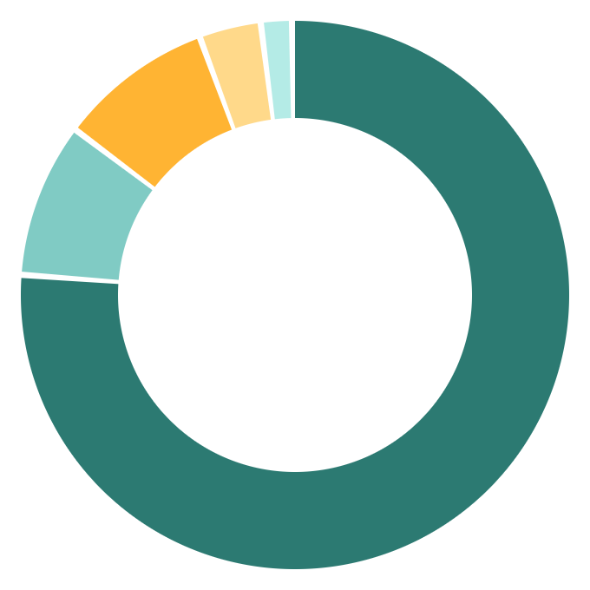

Three in four ads offer full-time jobs, yet 87% keep the salary hidden
EXECUTIVE DECK
04 · NATURE OF OFFERS AND PAY
Job Market Intelligence
Cameroon
Offer type · 55 described ads
Salary field · 55 described ads (100%)
00
Overview
87% negotiable
01
Publishing pace
Full-time 42
02
Territory
Internship 5
“À négocier” 48 · 87%
76%
Tender 5
Pay figure stated 2 · 4%
03
Employers & jobs
Training/promo 2
Fee charged to the reader 2 · 4%
full-time
Unpaid, n/a or civil-service grid 3 · 5%
04
Contracts & pay
Temporary 1
05
Data quality
Salary transparency index
06
Action plan
13%
4
4%
Only 2 of 48 job ads show pay: 80 000 FCFA (cashier) and one gross range
not jobs: tenders, training, promos
spontaneous-application calls
Source: cameroun.minajobs.net
Snapshot to 12 Oct 2026
Base: 55 described ads · no salary average computed (too few figures)
5 / 7
Notes:
Answers: split between full-time, internship, temporary, tenders and training, and how many ads show pay. 42 of 55 described ads are full-time jobs; 13% are not jobs at all (tenders, paid training, platform promos). 87% say “à négocier”; only 2 of 48 job ads state a figure, so the deck reports a transparency index rather than an average salary. Product lever: a structured salary field would differentiate the portal.

Slide 6



Half the rows are duplicates and 45% of ads carry no description
EXECUTIVE DECK
05 · DATA QUALITY AND RELIABILITY
Job Market Intelligence
Cameroon
From raw rows to usable ads
00
Overview
200
Raw rows
every link twice
50%
55%
62%
01
Publishing pace
02
Territory
100
Unique ads
−100 duplicates
Duplicate rows
Description coverage
Fields extracted (avg of 6)
03
Employers & jobs
55
With a description
−45 empty
Control table · run at every refresh
04
Contracts & pay
Check | Target | Actual | Status
Unique ads (link key) | 100 | 100 | Pass
Duplicates in model | 0 | 0 | Pass
Description coverage | ≥ 90% | 55% | Fail
Employer identified | ≥ 90% | 52% | Fail
Job family classified | ≥ 95% | 99% | Pass
Date parsed (described) | 100% | 100% | Pass
05
Data quality
52
Employer identified
−3 unnamed
06
Action plan
Impact on the indicators
Location, date, contract and pay KPIs rest on 55 ads: read as indicative. Job families cover 99 of 100.
Source: cameroun.minajobs.net
Snapshot to 12 Oct 2026
Fields: location, date, contract, pay, employer (of 100) · job family (of 100) · targets to validate
6 / 7
Notes:
Answers: duplicate, missing-description and extraction rates, and their impact. Every link appears twice (50% duplicate rows); 45 of 100 unique ads have no description, so location, date, contract and pay KPIs rest on 55 ads. Employer is identified for 52 ads; job family for 99 titles. The control table is built into the report and rerun at each refresh so two collections stay comparable.

Slide 7
Three moves make the data decision-grade; six risks to provision
EXECUTIVE DECK
06 · ACTION PLAN, ROI AND RISKS
Job Market Intelligence
Cameroon
P1
Capture full ads
P2
Collect weekly
P3
Widen sources
00
Overview
Scrape detail pages; dedupe on link at load.
Stamp a collection date; keep every snapshot.
Add 2 portals + an employer reference table.
01
Publishing pace
55% → ~100%
≈5 h → <2 min
52% → 90%
02
Territory
field coverage · +45 ads usable
per refresh* · trend after 12 weeks
employers identified (target)
03
Employers & jobs
Risk heat map · impact × likelihood
Risk → mitigation
04
Contracts & pay
Low
Medium
High
R1 Single source → state the limit; add portals (P3)
05
Data quality
R2 Empty descriptions → show coverage; full scrape (P1)
High impact
R6
R3
R1
R2
06
Action plan
R3 Site layout change → parameterised rules + QA check
Medium
R5
R4
R4 Hiring seasonality → weekly snapshots, no annual claims
Low
R5 Keyword misclassing → review the dictionary on edge cases
Source: cameroun.minajobs.net
Likelihood →
R6 Data-use compliance → public data only, source cited
Snapshot to 12 Oct 2026
* Assumption: 3 min of manual review per ad × 100 ads · targets to validate with the committee
7 / 7
Notes:
Answers: the three priorities with their expected gains, and the risks to provision. P1 scrapes each ad’s detail page and deduplicates at load, lifting field coverage from 55% to near 100%. P2 schedules weekly collections with a collection date, turning a snapshot into a time series; refresh is automated. P3 adds two portals and an employer reference table to cut single-source bias and raise employer identification. The time gain is an estimate (3 min of manual review per ad). Decision asked: approve P1 now, P2 and P3 for the next sprint.

